Slide 1
Cuts & Hustle
Made by: Káldy Gergő, Sinka Dominik

Slide 2
How we split the workforce
Káldy Gergő:
-MySQL Database
-Frontend
Sinka Dominik:
-Backend
-Javascript

Slide 3
What This Database Does
Manages a service-based business
(barbershop)
Tracks:
-employees
-users
-services
-appointments
Contains 4 core tables: employees, users, appointments, services

Slide 4
Storing Employee Info
Important employee information stored in the Database:
Id: Auto-generated ID for each employee
Name: Required, up to 100 characters, easy to update
Phone: Optional contact number for the manager to use, easy to update
Email: Required, up to 100 characters

Slide 5
Storing User Info
Important user information stored in the Database:
Id: Auto-generated ID for each user
Name: Required, up to 100 characters, easy to update
Password: Protected by bcrypt, cannot be seen from the database
Role: ENUM role is active, (e.g: „customer” users can only access the main website)
Email: Required, up to 100 characters

Slide 6
What the Services table offers
id — ID per service
name — Service name, up to 50 characters (e.g. "Haircut")
duration_minutes — How long the service takes
price — Cost of the service (stored as a whole number/integer)
Pictures — Stored in LONGBLOB

Slide 7
Booking an Appointment
customer_name + customer_phone: Who is booking
employee_id: Links to the unique employees table (who's doing the service)
service_id: Links to the services table (what's being done)
appointment_date + appointment_time: When it's scheduled(unique)
created_at: Automatically records when the booking was made

Slide 8
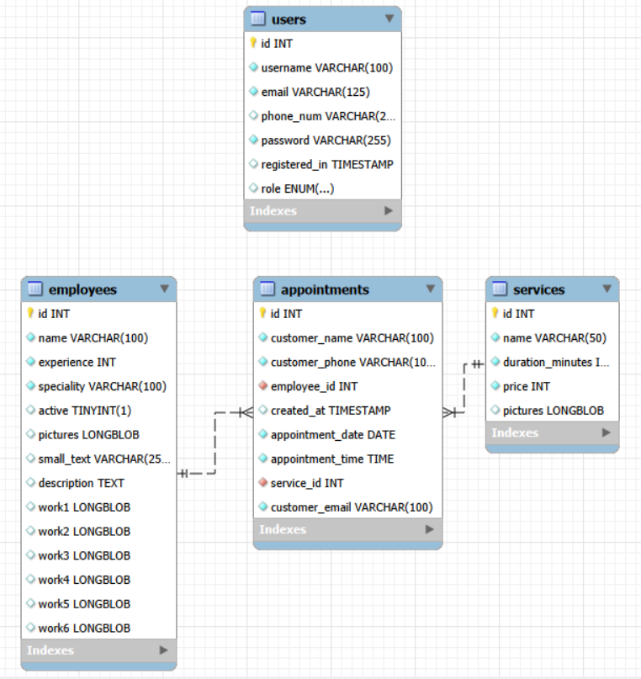
How Tables Connect
appointments.employee_id → employees.id
appointments.service_id → services.id
This ensures you can't book an appointment with a nonexistent employee or service
These are called foreign key constraints

Slide 9
Booking Flow -
What Happens Behind the Scenes
A customer views and decides on a service, it looks up the services table for the service_id
They pick an employee, it looks up the employees table for the employee_id
A new row is inserted into appointments with the customer's info, the chosen employee_id, service_id, date, and time
created_at is auto-filled with the current timestamp (date)
The database checks the foreign keys, if the ID doesn't exist, the insert is rejected

Slide 10
Summary; What We Covered
4 tables: employees, services, appointments,users
BLOB stores the pictures in .jpeg format
Foreign keys link tables and enforce data integrity
Data types, NOT NULL, and DEFAULT values keep the data clean and consistent
The booking flow ties all three tables together into one real-world operation

Slide 11
Thank you for your time!
If you have any other questions to ask, feel free

